Slide 1
Employee Salary Prediction & Interactive Web App Using Machine Learning
Presented By,
Name :Ashish Krishna Pavan Gade
College :Ideal Institute of Technology (Mechanical Engineering)
Aicte ID: STU637b915d35cff1669042525

Slide 2
OUTLINE
Problem Statement
System Development Approach
Algorithm & Deployment
Result
Conclusion
Future Scope
References

Slide 3
Problem Statement
The primary challenge is to predict whether an individual's income exceeds $50K per year based on census data.
The dataset is complex, containing a mix of demographic and financial attributes that require careful preprocessing.
A key difficulty is the significant class imbalance in the target variable, which can make accuracy a misleading metric.
The project goal is to develop a reliable classification model and deploy it in an interactive tool for real-time prediction of salary.

Slide 4
System Approach
The "System Approach" section outlines the overall strategy and methodology for developing and implementing. Here's a suggested structure for this section:
System requirements
Library required to build the model

Slide 5
System Requirements
Software Requirements:
Python 3.x Environment (e.g., Anaconda, Miniconda)
Jupyter Notebook / VS Code (for development)
Command Line Interface (for running apps)
Modern Web Browser (for Streamlit application)
Hardware Requirements:
Core i5/Ryzen 5 and above(Preferred H series)
Preferred Using GPU
RAM 16GB

Slide 6
Library required to build the model:
Data Handling: pandas, numpy
Data Visualization: matplotlib, seaborn
Machine Learning Models: scikit-learn (for various classifiers), xgboost
Model Saving/Loading: joblib
Web Application Framework: streamlit, streamlit-option-menu
System Utilities: psutil, os

Slide 7
Algorithm & Deployment
Data cleaning & preprocessing: handle missing values, standardize text, and prepare data for analysis.
Data filtering & feature engineering: apply age filters, remove low-frequency categories, and create new relevant features (e.G., Net capital).
Model training & comparison: train multiple machine learning models (logistic regression, knn, random forest, xgboost, mlp classifier) and evaluate their performance, primarily using f1 score.
Model saving & asset generation: save the best-performing model pipeline and generate performance reports (e.G., Model_performance.Csv).
Interactive application development (streamlit): build a user-friendly web application to integrate the trained model for real-time salary predictions.

Slide 8
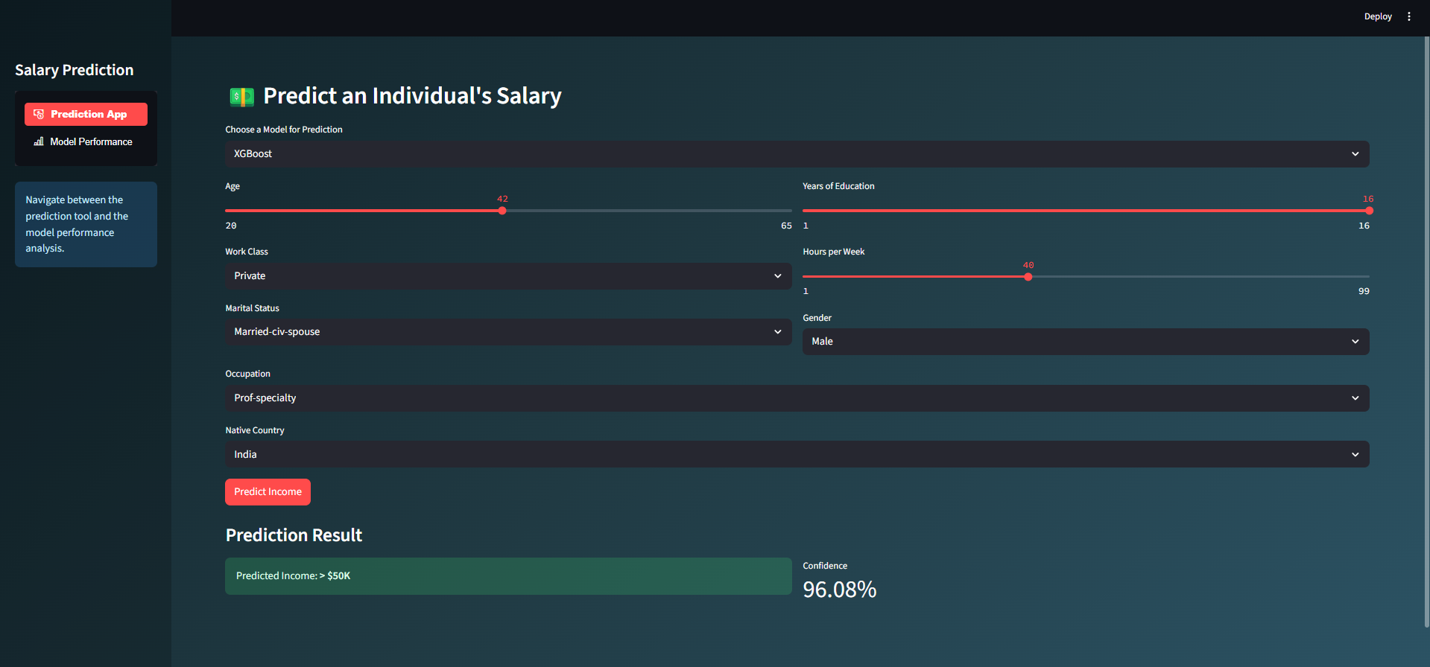
Result
1)Output Screenshots:
a)Application Interface:(With prediction in use)

Slide 9
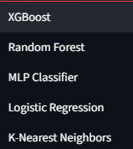
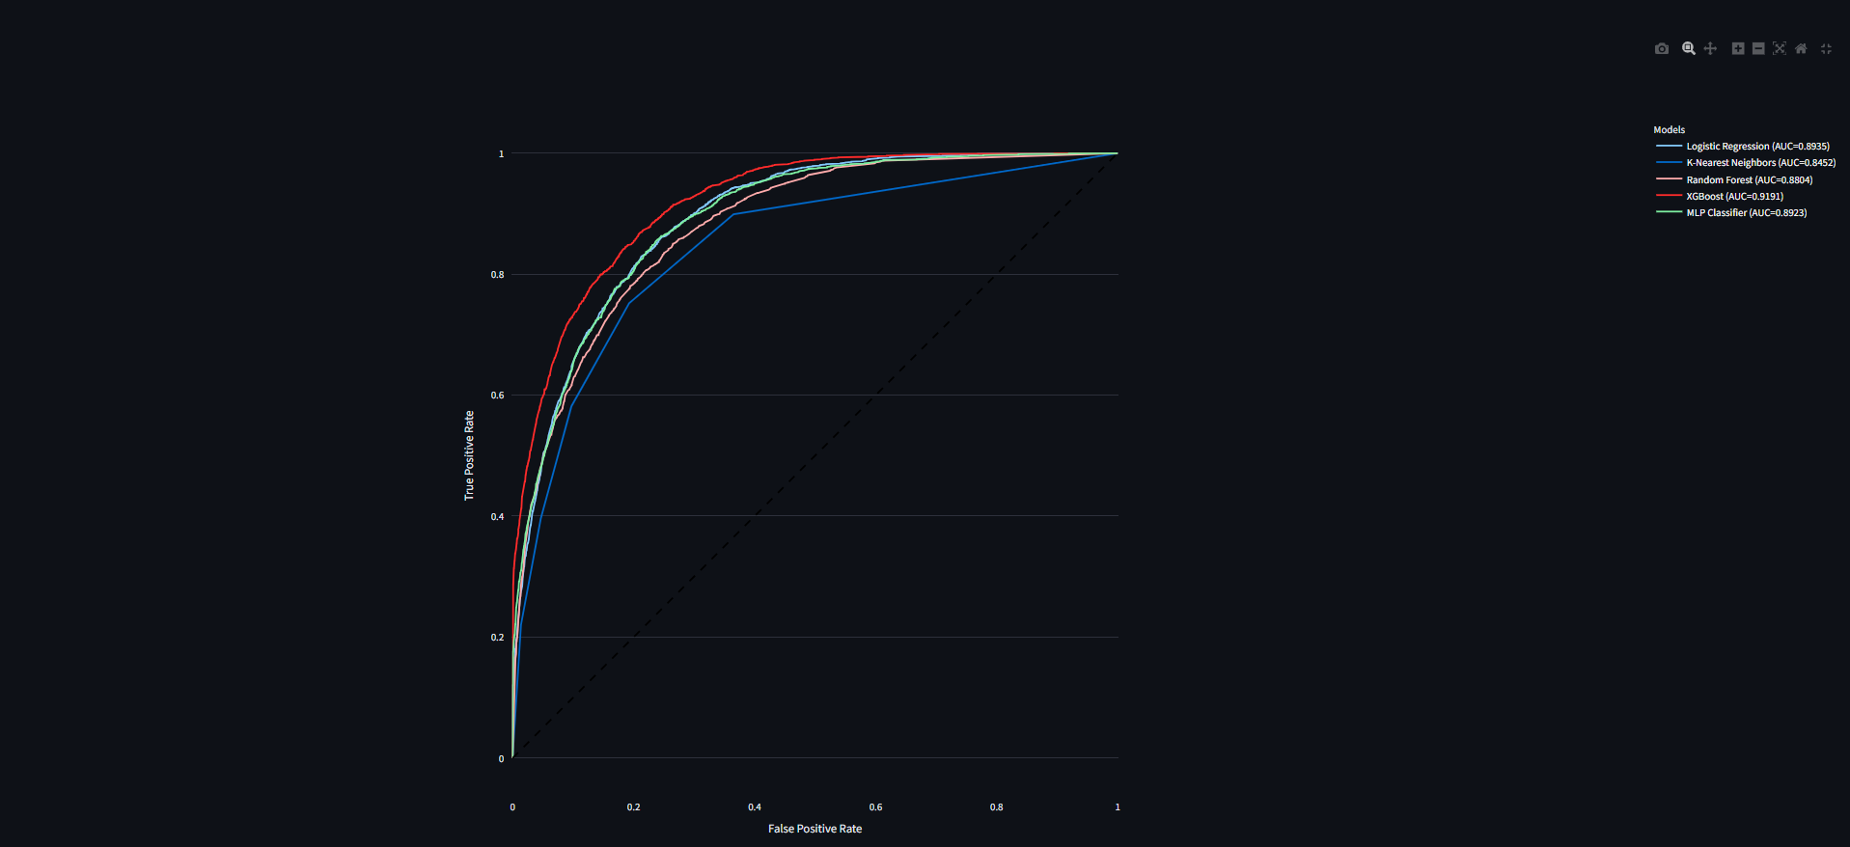
b)Available Models:
c) ROC Curve:

Slide 10
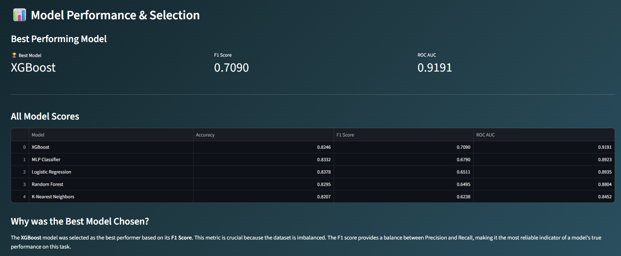
d) Model Performance Interface:

Slide 11
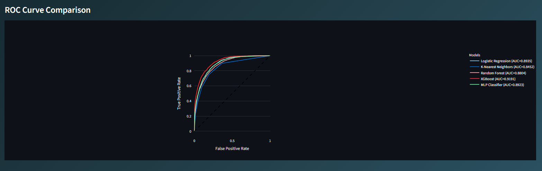
d) Model Performance Interface:

Slide 12
GitHub Link:
The Complete files of the project are available in the below git repository, Kindly go through readme file for understanding file structure and usage of files,
GitHub Link:
https://github.com/Ashish-Krishna-Pavan-git/Employee-Salary-Prediction-Using-Machine-Learning

Slide 13
Conclusion
1)Findings & Effectiveness
Effective Classification: Successfully built and compared multiple ML models for income prediction.
Optimal Model Selection: XGBoost emerged as the top performer (based on F1 Score), demonstrating robust classification on imbalanced data.
Interactive Solution: The Streamlit web app provides an intuitive and accessible platform for real-time predictions.

Slide 14
2)Challenges Encountered
Data Imbalance: Significant disparity between income classes required careful model selection and evaluation metrics (F1 Score).
Feature Engineering: Identifying impactful features (e.g., net_capital) was crucial but iterative.
Model Interpretation: Explaining complex model predictions can be challenging for end-users.

Slide 15
Future scope
Broader Data Sources: Integrate more diverse demographic and economic data.
Advanced Models: Explore deep learning architectures or ensemble methods for further accuracy gains.
User Feedback Loop: Implement mechanisms for continuous improvement based on user interactions.
Deployment Scaling: Optimize the application for larger user bases and production environments.

Slide 16
References
Edunet Classes
IBM Skills build Platform
Python Programming Language: www.python.org
Pandas: pandas.pydata.org (for data manipulation)
NumPy: numpy.org (for numerical operations)
Scikit-learn: scikit-learn.org (for machine learning algorithms)
XGBoost: xgboost.readthedocs.io (for gradient boosting)
Streamlit: streamlit.io (for interactive web application development)
Matplotlib & Seaborn: matplotlib.org, seaborn.pydata.org (for data visualization)
Joblib: joblib.readthedocs.io (for model persistence)
psutil: psutil.readthedocs.io (for process management in app)

Slide 17
THANK YOU

